Slide 1


How Can I Improve? Using GPT to Highlight the Desired and Undesired Parts of Open-ended Responses
Presenter: Jionghao Lin
Eason Chen
Zifei Han
Ashish Gurung
Danielle R. Thomas
Wei Tan
Ngoc Dang Nguyen
Kenneth R. Koedinger

Slide 2
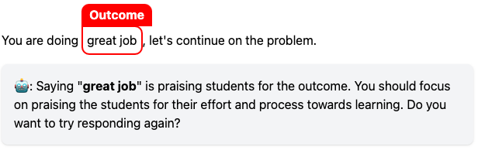
Research Questions (RQ):
RQ1: Does GPT provide accurate explanatory feedback?
RQ2: Does fine-tuning improve the accuracy?
Demo of a tutor receiving explanatory feedback within the lesson on giving effective praise

Slide 3
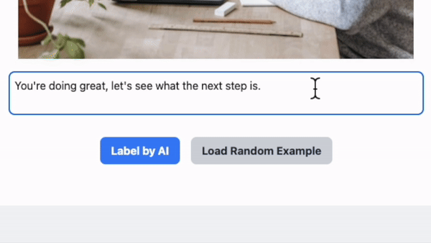

Provide feedback on trainee tutor responses
Fine-tuned GPT-3.5 for highlighting key components on novice tutors’ responses
Try our demo here

Slide 4

Background - Challenge
Tutoring is one of the most effective instructional methods which can help student improve their learning achievements, and yet:
Finding qualified tutors is difficult
Training tutors is more difficult
Providing tutoring to ALL students is the most difficult

Slide 5



PLUS is a platform designed to optimize tutoring
Personalized Learning Squared (PLUS)
Try our platform: https://tutors.plus

Slide 6
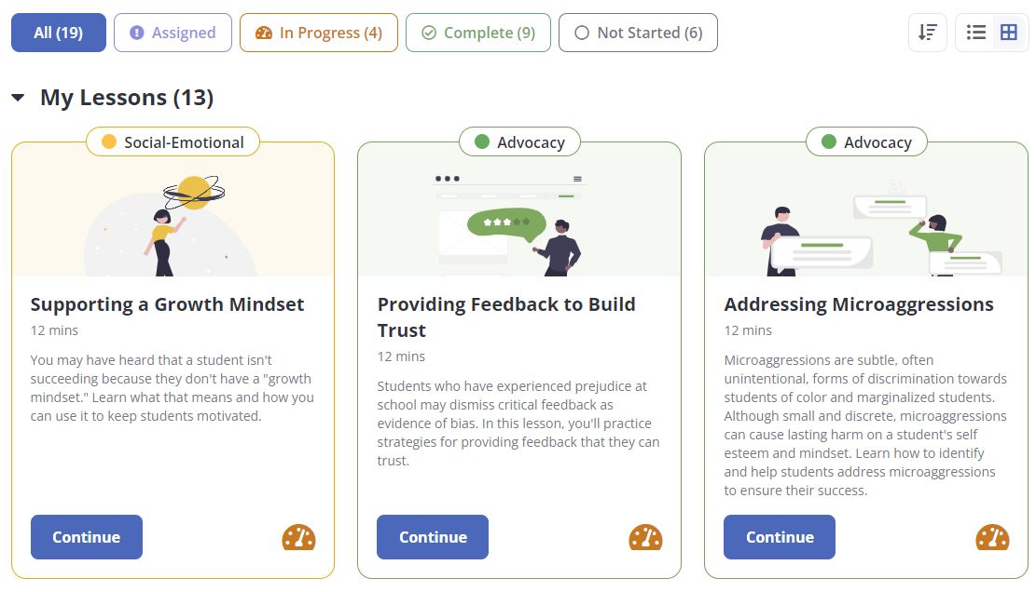
Background - PLUS Training Lessons

Slide 7
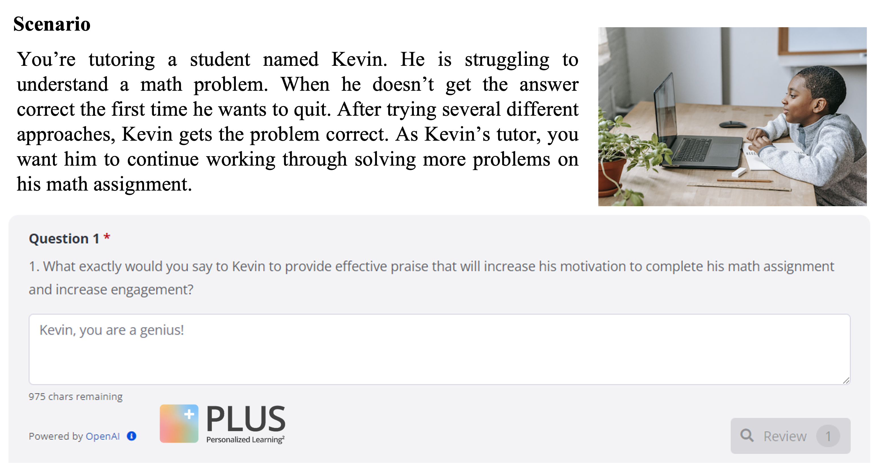
Scenario-based Question
Question scenario

Slide 8
Scenario-based Question
Question for trainees

Slide 9
Scenario-based Question
Trainee’s attempt

Slide 10
How can we use generative AI to provide feedback to tutor trainees?

Slide 11
Research Questions
RQ1: To what extent can we prompt the GPT models to enhance the prediction accuracy of providing explanatory feedback?
RQ2: To what extent can the fine-tuned GPT models enhance the prediction accuracy of providing explanatory feedback?

Slide 12
Research Questions
RQ1: To what extent can we prompt the GPT models to enhance the prediction accuracy of providing explanatory feedback?
Does prompting GPT provide accurate explanatory feedback?
RQ2: To what extent can the fine-tuned GPT models enhance the prediction accuracy of providing explanatory feedback?
Does fine-tuning improve the accuracy?

Slide 13
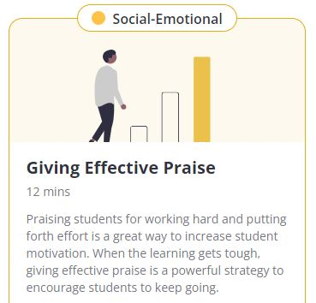
Focus: Giving Effective Praise
Train novice tutors (adult learners/trainees) to give effective praise for middle school students.
Effective Praise should be:
perceived as sincere and truthful.
detailed what the student did well, not generic (e.g., “great job” ).
focused on the student learning process
Thomas, D., Yang, X., Gupta, S., Adeniran, A., Mclaughlin, E., & Koedinger, K. (2023, March). When the tutor becomes the student: Design and evaluation of efficient scenario-based lessons for tutors. In LAK23: 13th International Learning Analytics and Knowledge Conference (pp. 250-261).

Slide 14
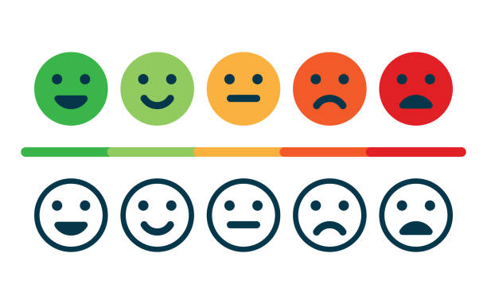
Praise Types
Effort-based praise: focus on the learning process (e.g., “I like how you worked hard to…”). Outcome-based praise: focus on student's achievements, such as getting a problem correct, and is often, but not always, associated with unproductive praise (e.g., “Great job!”).
Thomas, D., Yang, X., Gupta, S., Adeniran, A., Mclaughlin, E., & Koedinger, K. (2023, March). When the tutor becomes the student: Design and evaluation of efficient scenario-based lessons for tutors. In LAK23: 13th International Learning Analytics and Knowledge Conference (pp. 250-261).

Slide 15
Provide feedback on trainee tutor responses
Effort-based praise Outcome-based praise
Trainee tutor: “Good effort working through this, let’s move to the next problem.”
Feedback for the trainee tutor:
Saying “Good effort working through this” is a nice example of effort-based praise, which praises students for their effort.

Slide 16
Provide feedback on trainee tutor responses
Effort-based praise Outcome-based praise
Trainee tutor: “Good effort working through this, let’s move to the next problem.”
Feedback for the trainee tutor:
Saying “Good effort working through this” is a nice example of effort-based praise, which praises students for their effort.

Slide 17
Provide feedback on trainee tutor responses
Effort-based praise Outcome-based praise
Trainee tutor: “Well done, Kevin! Let’s work on the next one”
Feedback for the trainee tutor:
Saying “Well done” is praising students for the outcome. You should focus on praising the students for their effort and process towards learning. Do you want to try responding again?

Slide 18
Provide feedback on trainee tutor responses
- RQ1: Does GPT provide accurate explanatory feedback?
- RQ2: Does fine-tuning improve the accuracy?
Trainee tutor responses
(N = 129)
Founding source: Richard King Mellon Foundation, USA
Lin, J., Chen, E., Han, F., Gurung, A., Thomas, D. R., Tan, W., Ngoc, D. N., & Koedinger, K. R. (2024). How Can I Improve? Using GPT to Highlight the Desired and Undesired Parts of Open-ended Responses. 17th International Conference on Educational Data Mining
Aleven, V., Popescu, O., & Koedinger, K. R. (2001). Towards tutorial dialog to support self-explanation: Adding natural language understanding to a cognitive tutor. In Proceedings of Artificial Intelligence in Education (pp. 246-255).

Slide 19
Provide feedback on trainee tutor responses
- RQ1: Does GPT provide accurate explanatory feedback?
- RQ2: Does fine-tuning improve the accuracy?
Trainee tutor responses
(N = 129)
Expert labeling
Founding source: Richard King Mellon Foundation, USA
Lin, J., Chen, E., Han, F., Gurung, A., Thomas, D. R., Tan, W., Ngoc, D. N., & Koedinger, K. R. (2024). How Can I Improve? Using GPT to Highlight the Desired and Undesired Parts of Open-ended Responses. 17th International Conference on Educational Data Mining
Aleven, V., Popescu, O., & Koedinger, K. R. (2001). Towards tutorial dialog to support self-explanation: Adding natural language understanding to a cognitive tutor. In Proceedings of Artificial Intelligence in Education (pp. 246-255).

Slide 20
Provide feedback on trainee tutor responses
- RQ1: Does GPT provide accurate explanatory feedback?
- RQ2: Does fine-tuning improve the accuracy?
Trainee tutor responses
(N = 129)
Expert labeling
Prompting (RQ1) &
Fine-tune (RQ2)
GPT-3.5 & 4 models
Founding source: Richard King Mellon Foundation, USA
Lin, J., Chen, E., Han, F., Gurung, A., Thomas, D. R., Tan, W., Ngoc, D. N., & Koedinger, K. R. (2024). How Can I Improve? Using GPT to Highlight the Desired and Undesired Parts of Open-ended Responses. 17th International Conference on Educational Data Mining
Aleven, V., Popescu, O., & Koedinger, K. R. (2001). Towards tutorial dialog to support self-explanation: Adding natural language understanding to a cognitive tutor. In Proceedings of Artificial Intelligence in Education (pp. 246-255).

Slide 21
Provide feedback on trainee tutor responses
- RQ1: Does GPT provide accurate explanatory feedback?
- RQ2: Does fine-tuning improve the accuracy?
Trainee tutor responses
(N = 129)
Expert labeling
Prompting (RQ1) &
Fine-tune (RQ2)
GPT-3.5 & 4 models
Templated explanatory feedback
Founding source: Richard King Mellon Foundation, USA
Lin, J., Chen, E., Han, F., Gurung, A., Thomas, D. R., Tan, W., Ngoc, D. N., & Koedinger, K. R. (2024). How Can I Improve? Using GPT to Highlight the Desired and Undesired Parts of Open-ended Responses. 17th International Conference on Educational Data Mining
Aleven, V., Popescu, O., & Koedinger, K. R. (2001). Towards tutorial dialog to support self-explanation: Adding natural language understanding to a cognitive tutor. In Proceedings of Artificial Intelligence in Education (pp. 246-255).

Slide 22
RQ1: Does GPT provide accurate explanatory feedback?
Highlights:
Proposed and validated a metric (M-IoU) to measure the quality of highlighted components identified by GPT models
Prompted GPT models to highlight the desired and undesired components from trainees’ responses

Slide 23
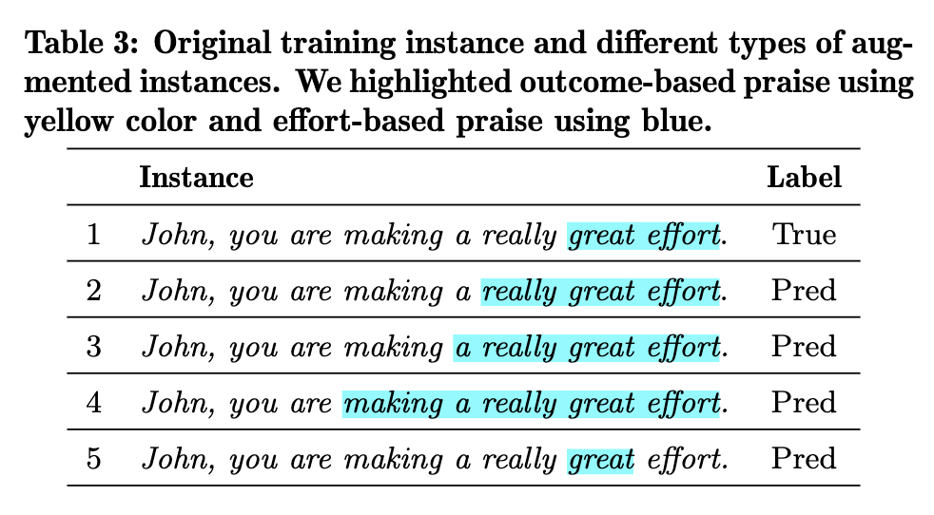
RQ1: Does GPT provide accurate explanatory feedback?
- Quality of sequence labeling
Score
1
Lin, J., Thomas, D. R., Han, F., Gupta, S., Tan, W., Nguyen, N. D., & Koedinger, K. R. (2023). Using large language models to provide explanatory feedback to human tutors. AIED 2023 Workshop - Towards the Future of AI-augmented Human Tutoring in Math Learning

Slide 24
RQ1: Does GPT provide accurate explanatory feedback?
- Quality of sequence labeling
Score
1
0.84
0.68
0.52
Smaller penalty for extra predictions
Lin, J., Thomas, D. R., Han, F., Gupta, S., Tan, W., Nguyen, N. D., & Koedinger, K. R. (2023). Using large language models to provide explanatory feedback to human tutors. AIED 2023 Workshop - Towards the Future of AI-augmented Human Tutoring in Math Learning

Slide 25
RQ1: Does GPT provide accurate explanatory feedback?
- Quality of sequence labeling
Score
1
0.84
0.68
0.52
0.2
Larger penalty for missing predictions
Lin, J., Thomas, D. R., Han, F., Gupta, S., Tan, W., Nguyen, N. D., & Koedinger, K. R. (2023). Using large language models to provide explanatory feedback to human tutors. AIED 2023 Workshop - Towards the Future of AI-augmented Human Tutoring in Math Learning

Slide 26
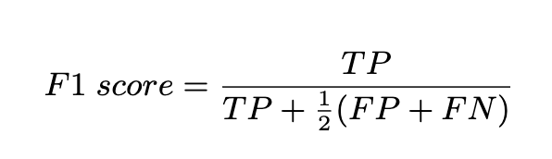
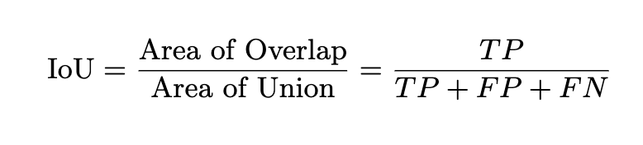
RQ1: Does GPT provide accurate explanatory feedback?
- Modified Intersection over Union (M-IOU)
TP – True Positive FP – False Positive FN – False Negative
Smaller penalty for extra predictions, larger penalty for missing predictions

Slide 27
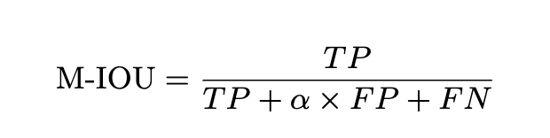
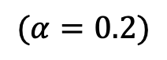
RQ1: Does GPT provide accurate explanatory feedback?
- Modified Intersection over Union (M-IOU)
TP – True Positive FP – False Positive FN – False Negative
Smaller penalty for extra predictions, larger penalty for missing predictions
$$(α=0.2)$$
M-IoU is used to measure the quality of highlighted components of tutor praise responses

Slide 28
RQ1: Does GPT provide accurate explanatory feedback?
- Modified Intersection over Union (M-IOU)
Validate M-IOU score
Two human coders were assigned to evaluate the quality (five-point Likert scale) of shuffled highlighted responses, specifically focusing on the components of effort and outcome praise

Slide 29
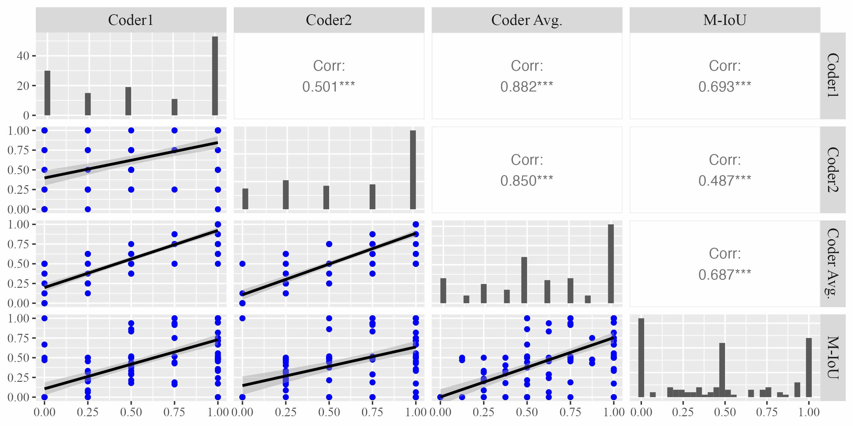
RQ1: Does GPT provide accurate explanatory feedback?
- Validate M-IOU score on effort-based praise

Slide 30
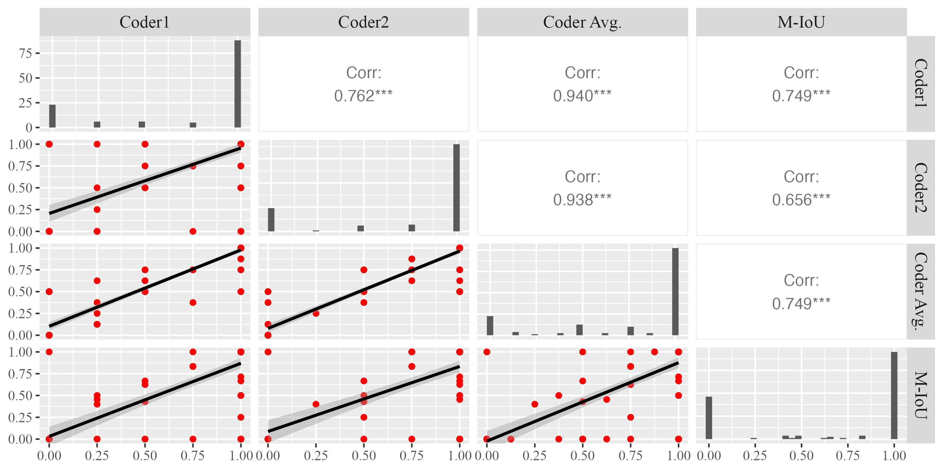
RQ1: Does GPT provide accurate explanatory feedback?
- Validate M-IOU score on outcome-based praise

Slide 31
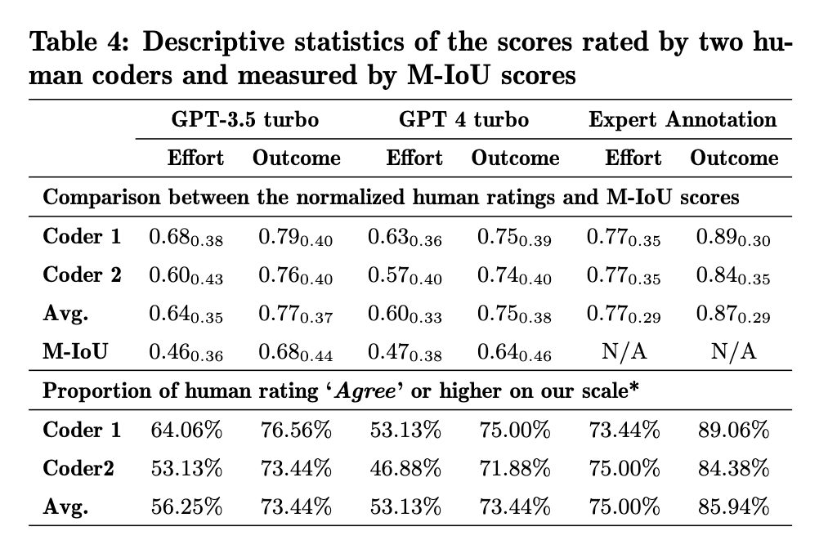
RQ1: Does GPT provide accurate explanatory feedback?
- Analysis of prompting GPT models for highlighting key components
Human coders rate expert’s highlight as accurate about 80% of the time and they rate GPT-3.5 as accurate about 65% of the time.

Slide 32
RQ1: Does GPT provide accurate explanatory feedback?
- M-IoU scores for expert annotation on effort-based praise

Slide 33
RQ1: Does GPT provide accurate explanatory feedback?
- M-IoU scores for expert annotation on effort-based praise

Slide 34
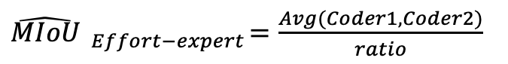
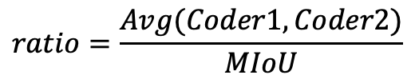
RQ1: Does GPT provide accurate explanatory feedback?
- M-IoU scores for expert annotation on effort-based praise
$$ratio=\frac{Avg(Coder1, Coder2)}{MIoU}$$
$\hat{MIoU} _{Effort−expert}=\frac{Avg(Coder1, Coder2)}{ratio}$

Slide 35
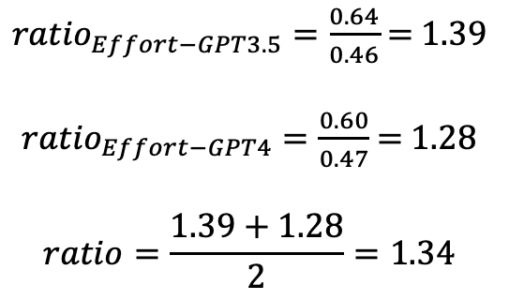
RQ1: Does GPT provide accurate explanatory feedback?
- M-IoU scores for expert annotation on effort-based praise
$$ratio=\frac{Avg(Coder1, Coder2)}{MIoU}$$
${ratio}_{Effort−GPT3.5}=\frac{0.64}{0.46}$ = 1.39
${ratio}_{Effort−GPT4}=\frac{0.60}{0.47}$ = 1.28
$$ratio=\frac{1.39+1.28}{2}=1.34$$

Slide 36

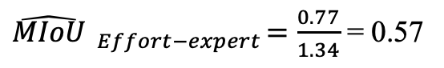
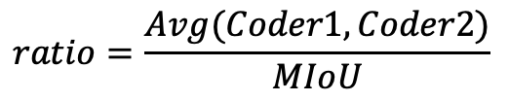
RQ1: Does GPT provide accurate explanatory feedback?
- M-IoU scores for expert annotation on effort-based praise
$$ratio=\frac{Avg(Coder1, Coder2)}{MIoU}$$
0.57
$\hat{MIoU} _{Effort−expert}=\frac{0.77}{1.34}$ = 0.57
If the prediction on effort-based praise can achieve an M-IoU of 0.57, the quality is comparable to expert annotation.

Slide 37

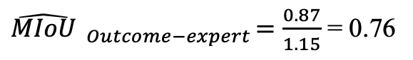
RQ1: Does GPT provide accurate explanatory feedback?
- M-IoU scores for expert annotation on outcome-based praise
$$ratio=\frac{Avg(Coder1, Coder2)}{MIoU}$$
0.57
0.76
$\hat{MIoU} _{Outcome−expert}=\frac{0.87}{1.15}$ = 0.76
If the prediction on outcome-based praise can achieve an M-IoU of 0.76, the quality is comparable to expert annotation.

Slide 38
RQ2: Does fine-tuning improve the accuracy?
Highlights:
Fine-tuning GPT-3.5 can improve the accuracy of highlighting the desired and undesired components in trainees’ responses
Examine the influence of different ratios of fine-tuning set on model performance.

Slide 39
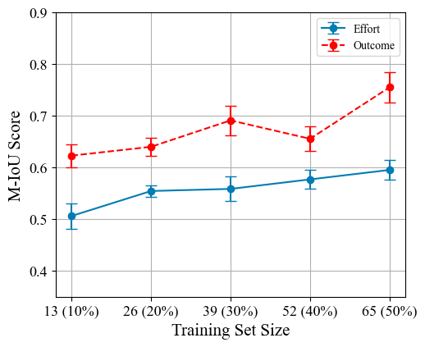
RQ2: Does fine-tuning improve the accuracy?
- Analysis of finetuning GPT models for highlighting key components
Praise type | Min (M-IoU) | Mean (M-IoU) | Max (M-IoU)
Effort | 0.54 | 0.60 | 0.64
Outcome | 0.66 | 0.76 | 0.84

Slide 40
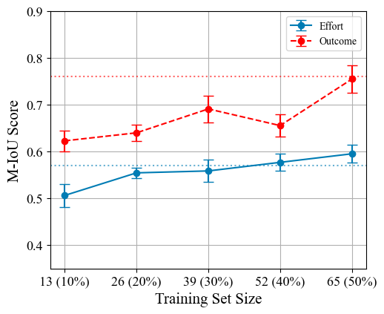
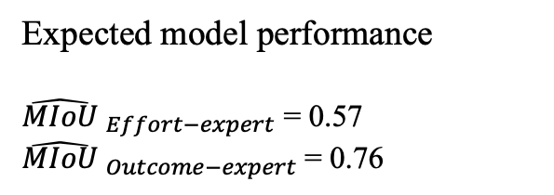
RQ2: Does fine-tuning improve the accuracy?
- Analysis of finetuning GPT models for highlighting key components
Praise type | Min (M-IoU) | Mean (M-IoU) | Max (M-IoU)
Effort | 0.54 | 0.60 | 0.64
Outcome | 0.66 | 0.76 | 0.84
0.76
0.57
Expected model performance
$\hat{MIoU} _{Effort−expert}$ = 0.57
$\hat{MIoU} _{Outcome−expert}$= 0.76

Slide 41
Ongoing and Future Works
Data Augmentation

Slide 42
Our mission is to double math learning for 10,000 middle school students by 2026.

